Slide 1
Leasing Facts
Lease – contractual agreement between a lessor (owner) and a lessee (user or renter) that gives the lessee the right to use an asset owned by the lessor for the lease term.
MLP – minimum lease payments (MLP) of the lessee to the lessor according to the lease contract

Slide 2
Lease Accounting and Reporting
(1) Capital Lease: leases that transfer substantially all benefits and risks of ownership—accounted for as an asset acquisition and a liability incurrence by the lessee, and as a sale and financing transaction by the lessor
A lessee classifies and accounts for a lease as a capital lease if, at its inception, the lease meets any of four criteria:
Lease transfers the ownership of the property to lessee by the end of the lease term
Lease contains an option to purchase the property at a bargain price
Lease term is 75% or more of estimated economic life of the property
The present value of minimum lease payments at the beginning of lease term is 90% or more of the fair value of leased property
(2) Operating Lease : None of the above criteria are met

Slide 3
Lease Accounting and Reporting
Capital Lease Accounting:
Recorded at an amount equal to the present value of MLP
The leased asset and the lease obligation (lease liability) are recognized on the balance sheet.
The leased asset must be depreciated
Interest expense is accrued on the lease liability.
Operating Lease Accounting
Minimum lease payments are recognized as a rental expense (income)
No asset or liability is recognized on the balance sheet

Slide 4
Accounting for Leases – An Illustration
A company leases an asset on January 1, 2005, it has no other assets or liabilities
Estimated economic life of the leased asset is 5 years. Its salvage value is zero. The straight-line basis is applied.
MLP is $2,505 each year
Interest rate is 8% per year

Slide 5
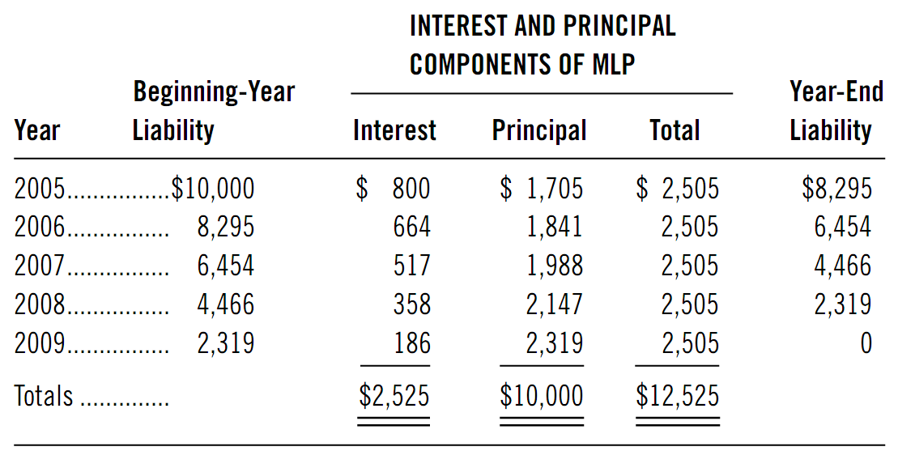
Accounting for Leases – An Illustration Lease Amortization Schedule

Slide 6
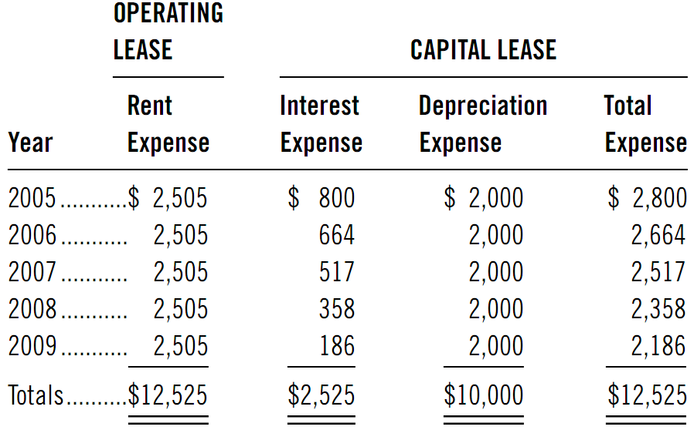
Accounting for Leases – An Illustration Income Statement Effects of Alternative Lease Accounting Methods

Slide 7
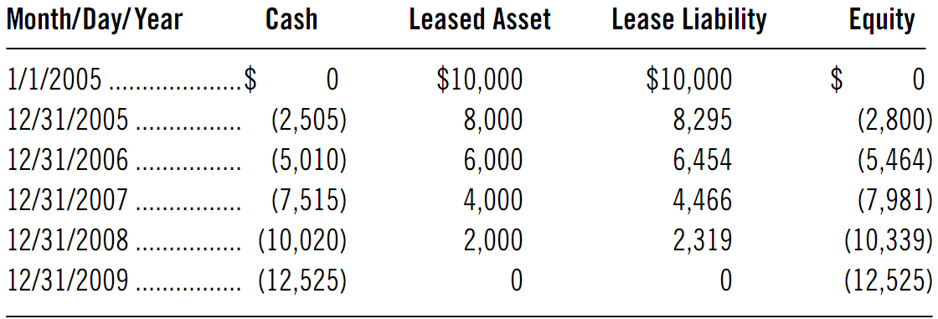
Accounting for Leases – An Illustration Balance Sheet Effects of Capital Leases

Slide 8
Effects of Lease Accounting
Impact of Operating Lease versus Capital Lease:
Operating lease understates liabilities—improves solvency ratios such as debt to equity
Operating lease understates assets—can improve return on investment ratios and asset turnover ratios
Operating lease delays expense recognition—overstate income in early term of the lease and understate income later in lease term
Operating lease understates current liabilities by ignoring current portion of lease principal payment—inflates current ratio & other liquidity measures
Operating lease includes interest with lease rental (an operating expense)—understates both operating income and interest expense -> inflates interest coverage ratios.

Slide 9

Accrual accounting vs cash flow accounting
Accounting analysis process
An overview of basic accounting principles

